Slide 1
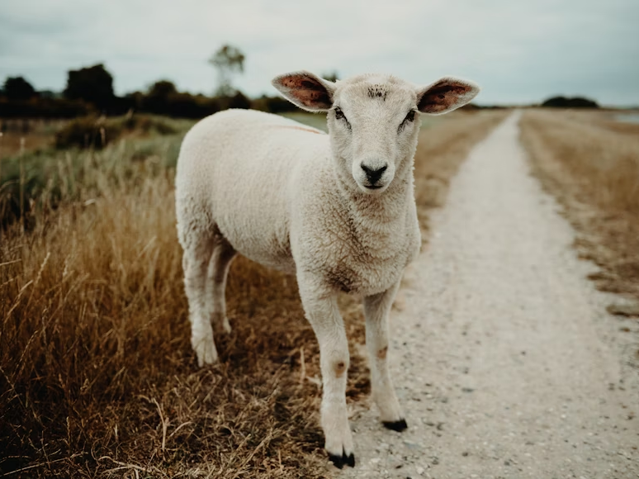
He Leads Me in the Paths of Righteousness
Psalm 23:3
Notes:
Jesus, the Good Shepherd, came to seek and save the lost. He makes us right when we have gone wrong. He leads us in the paths of righteousness for His name’s sake. We pursue righteousness by following Him, and we are blessed with its benefits as we heed His voice exclusively.

Slide 2
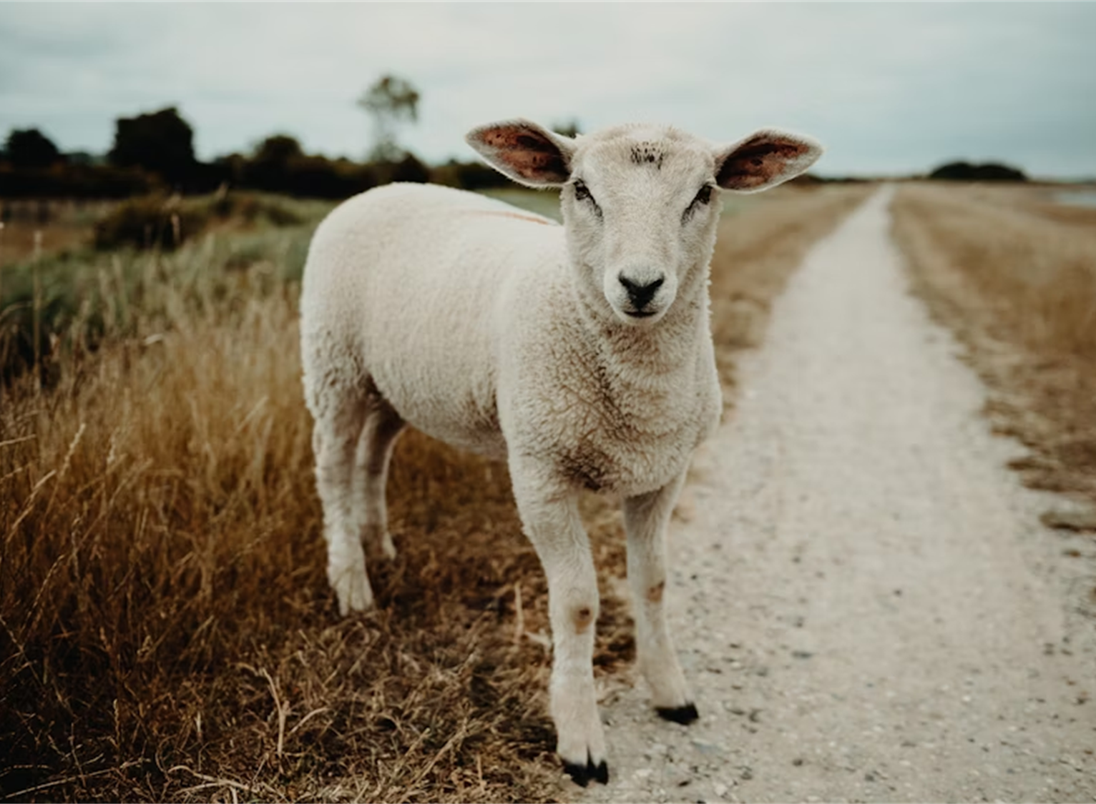
The Righteous shall Live by Faith!
The righteousness of God revealed in the gospel of Christ makes believers righteous (Romans 1:16-17; 1 John 5:11).
Those who have been made righteous pursue righteous living (Habakkuk 2:4; Hebrews 10:36-38).
Saints in Corinth were challenged to live righteous lives (1 Cor. 6:9-18; 2 Tim. 2:22).

Slide 3
The Shepherd Restores the Sheep
Jesus made us right when we had gone wrong (Isaiah 53:6; John 10:11).
He came to seek and save the lost (Matthew 18:11-14).

Slide 4
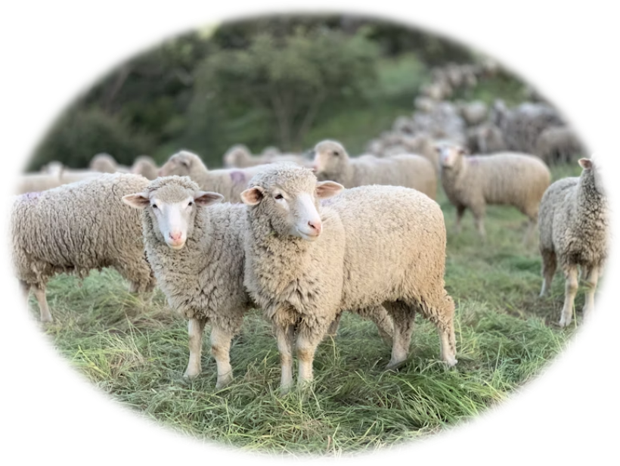
He Leads Me in the Paths of Righteousness
The sheep follow only the Shepherd (John 10:3-5, 27; Psalms 5:8; 85:13; Hosea 14:9).
He leads us in right ways! (Jeremiah 10:23; Ezekiel 37:24; Hebrews 13:20-21 )
If we follow His leading…
He will help us avoid temptation (Matthew 6:13).
We will be at peace with fellow sheep (Ezek. 34:17-24).
We will not die eternally (Prov. 12:28; John 11:26).

Slide 5
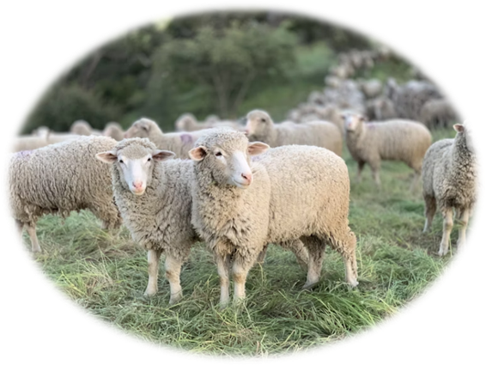
Pursuing Righteousness “For His Name’s Sake”
God’s majestic name is seen in His relationship with His sheep (Micah 5:4).
The name of the Lord is profaned when His sheep do not follow Him (1 Timothy 6:1).
The sheep belong to the shepherd, and He has a purpose for them (Psalm 100:3; Isaiah 43;7; Ephesians 1:12).

Slide 6
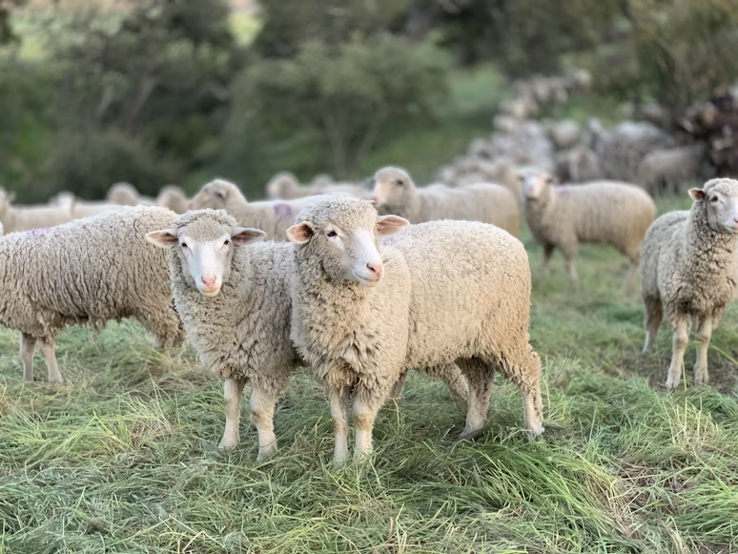
Let us Walk in Righteousness
“Oh, magnify the LORD with me, and let us exalt His name together.” (Psalms 34:3)

